Slide 1
UNIT-5
DNS, DDNS, TELNET, EMAIL, FTP
WWW, HTTP, SNMP,
Cryptography :basic concept

Slide 2
DNS (Domain Name Server)
There are several applications in the application layer of the Internet model that follow the client/server paradigm.
The client/server programs can be divided into two categories: those that can be directly used by the user, such as e-mail, and those that support other application programs.
The Domain Name System (DNS) is a supporting program that is used by other programs such as e-mail.

Slide 3
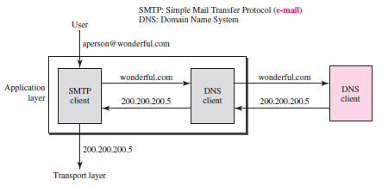
Example of Using DNS services

Slide 4
NAME SPACE
A name space that maps each address to a unique name can be organized in two ways: flat or hierarchical.
Flat Name Space – In a flat name space, a name is assigned to an address. A name in this space is a sequence of characters without structure
Hierarchical Name Space -In a hierarchical name space, each name is made of several parts. The first part can define the nature of the organization, the second part can define the name of an organization, the third part can define departments in the organization, and so on

Slide 5
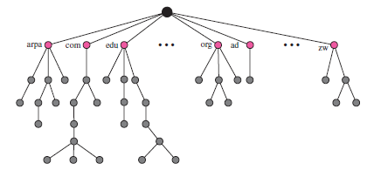
DOMAIN NAME SPACE
To have a hierarchical name space, a domain name space was designed.
In this design the names are defined in an inverted-tree structure with the root at the top.
The tree can have only 128 levels: level 0 (root) to level 127

Slide 6
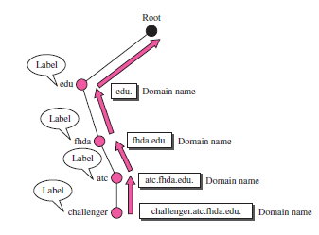
DOMAIN NAME SPACE
Domain Name
Each node in the tree has a domain name. A full domain name is a sequence of labels separated by dots (.).
The domain names are always read from the node up to the root. The last label is the label of the root (null)

Slide 7
DOMAIN NAME SPACE
Fully Qualified Domain Name
If a label is terminated by a null string, it is called a fully qualified domain name (FQDN). An FQDN is a domain name that contains the full name of a host
For example, the domain name
is the FQDN of a computer named challenger installed at the Advanced Technology Center (ATC) at De Anza College
Partially Qualified Domain Name
If a label is not terminated by a null string, it is called a partially qualified domain name (PQDN). A PQDN starts from a node, but it does not reach the root

Slide 8

DOMAIN NAME SPACE
Domain
A domain is a subtree of the domain name space. The name of the domain is the domain name of the node at the top of the subtree

Slide 9
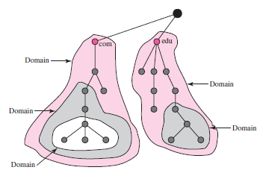
DISTRIBUTION OF NAME SPACE
The information contained in the domain name space must be stored.
However, it is very inefficient and also unreliable to have just one computer store such a huge amount of information.
It is inefficient because responding to requests from all over the world places a heavy load on the system.

Slide 10
The solution to these problems is to distribute the information among many computers called DNS servers.
One way to do this is to divide the whole space into many domains based on the first level.
In other words, we let the root stand alone and create as many domains (subtrees) as there are first-level nodes.
Because a domain created in this way could be very large, DNS allows domains to be divided further into smaller domains (subdomains).
Each server can be responsible (authoritative) for either a large or a small domain.
In other words, we have a hierarchy of servers in the same way that we have a hierarchy of names

Slide 11
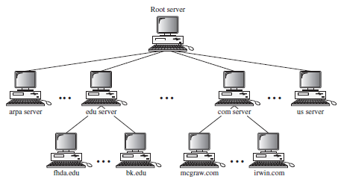
Root Server
A root server is a server whose zone consists of the whole tree.
A root server usually does not store any information about domains but delegates its authority to other servers, keeping references to those servers

Slide 12
Primary and Secondary DNS Servers
DNS defines two types of servers: primary and secondary. A primary server is a server that stores a file about the zone for which it is an authority.
It is responsible for creating, maintaining, and updating the zone file. It stores the zone file on a local disk.
A secondary server is a server that transfers the complete information about a zone from another server (primary or secondary) and stores the file on its local disk

Slide 13
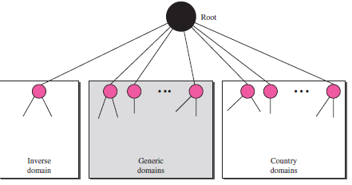
DNS IN THE INTERNET
DNS is a protocol that can be used in different platforms.
In the Internet, the domain name space (tree) is divided into three different sections:
Generic domains,
Country domains, and
the inverse domain

Slide 14
DNS IN THE INTERNET
Generic Domains
The generic domains define registered hosts according to their generic behaviour.
Each node in the tree defines a domain, which is an index to the domain name space database
Looking at the tree, we see that the first level in the generic domains section allows 14 possible labels. These labels describe the organization types as listed in Table
Country Domains
The country domains section uses two-character country abbreviations (e.g., us for United States). Second labels can be organizational, or they can be more specific, national designations.

Slide 15
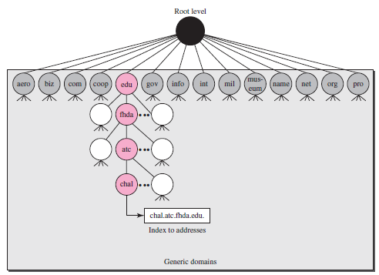
Generic domain

Slide 16
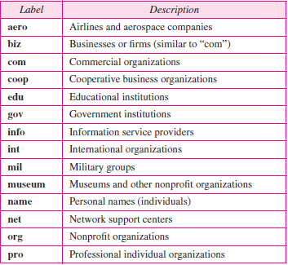
First label domain name

Slide 17
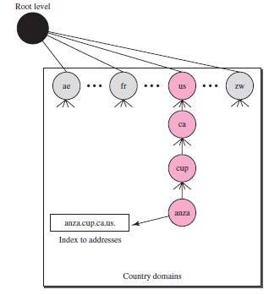
Country domain

Slide 18
Inverse Domain
The inverse domain is used to map an address to a name.
This may happen, for example, when a server has received a request from a client to do a task.
Although the server has a file that contains a list of authorized clients, only the IP address of the client (extracted from the received IP packet) is listed The server asks its resolver to send a query to the DNS server to map an address to a name to determine if the client is on the authorized list.
The servers that handle the inverse domain are also hierarchical. This means the netid part of the address should be at a higher level than the subnetid part, and the subnetid part higher than the hostid part
For example IP address such as 132.34.45.121

Slide 19
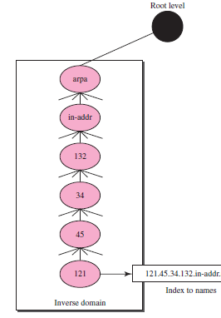

Slide 20
Resolution in DNS
Mapping a name to an address or an address to a name is called name-address resolution.
Resolver
DNS is designed as a client/server application. A host that needs to map an address to a name or a name to an address calls a DNS client called a resolver.
The resolver accesses the closest DNS server with a mapping request. If the server has the information, it satisfies the resolver; otherwise, it either refers the resolver to other servers or asks other servers to provide the information.
After the resolver receives the mapping, it interprets the response to see if it is a real resolution or an error, and finally delivers the result to the process that requested it.

Slide 21
DNS MESSAGES
DNS has two types of messages: query and response. Both types have the same format.
The query message consists of a header and question records;
The response message consists of a header, question records, answer records, authoritative records, and additional records
Header
Both query and response messages have the same header format with some fields set to zero for the query messages. The header is 12 bytes, and its format is shown in Figure

Slide 22
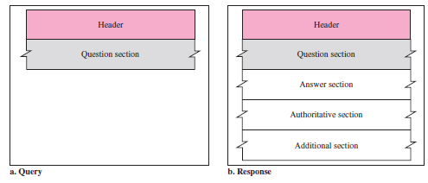
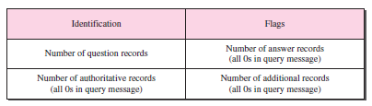

Slide 23
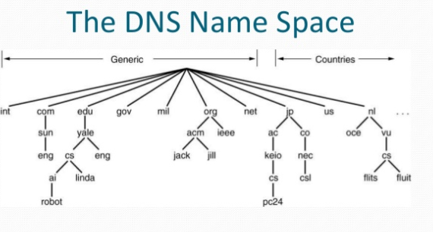

Slide 24
Problem with basic DNS
The standard DNS protocol enables us to find out the public IP address of a computer, given its domain name. But DNS assumes a static IP address for end computers and would not work properly if the IP addresses of end computers keep changing frequently.
Due to the additional cost associated with obtaining a static IP address and also due to the limit in the number of available static IP addresses, a significant percentage of computers connected to the public internet do not have static IP addresses.

Slide 25
Dynamic DNS
Dynamic DNS (DDNS) is an extension to the DNS protocol that enables computers and servers to always have the same domain name even if their public IP address keeps changing often

Slide 26
DYNAMIC DOMAIN NAME SYSTEM (DDNS)
When the DNS was designed, no one predicted that there would be so many address changes.
In DNS, when there is a change, such as adding a new host, removing a host, or changing an IP address, the change must be made to the DNS master file.
These types of changes involve a lot of manual updating.
The size of today’s Internet does not allow for this kind of manual operation.
The DNS master file must be updated dynamically.
The Dynamic Domain Name System (DDNS) therefore was devised to respond to this need.
In DDNS, when a binding between a name and an address is determined, the information is sent, usually by DHCP to a primary DNS server.

Slide 27
DYNAMIC DOMAIN NAME SYSTEM (DDNS)
The primary server updates the zone. The secondary servers are notified either actively or passively.
In active notification, the primary server sends a message to the secondary servers about the change in the zone, whereas in passive notification, the secondary servers periodically check for any changes.
In either case, after being notified about the change, the secondary requests information about the entire zone (zone transfer).
To provide security and prevent unauthorized changes in the DNS records, DDNS can use an authentication mechanism.

Slide 28
Telnet (port 23) (teletype network)
Telnet is a protocol that allows you to connect to remote computers (called hosts) over a TCP/IP network (such as the Internet).
Using telnet client software on your computer, you can make a connection to a telnet server (i.e., the remote host).
It is the standard TCP/IP protocol for virtual terminal service as proposed by the International Organization for Standards (ISO).
TELNET enables the establishment of a connection to a remote system in such a way that the local terminal appears to be a terminal at the remote system.
Timesharing Environment
TELNET was designed at a time when most operating systems, such as UNIX, were operating in a timesharing environment.
In such an environment, a large computer supports multiple users.
The interaction between a user and the computer occurs through a terminal, which is usually a combination of keyboard, monitor, and mouse

Slide 29
TELNET
Logging
In a timesharing environment, users are part of the system with some right to access resources.
Each authorized user has an identification and probably a password.
The user identification defines the user as part of the system. To access the system, the user logs into the system with a user id or log-in name.
The system also includes password checking to prevent an unauthorized user from accessing the resources

Slide 30
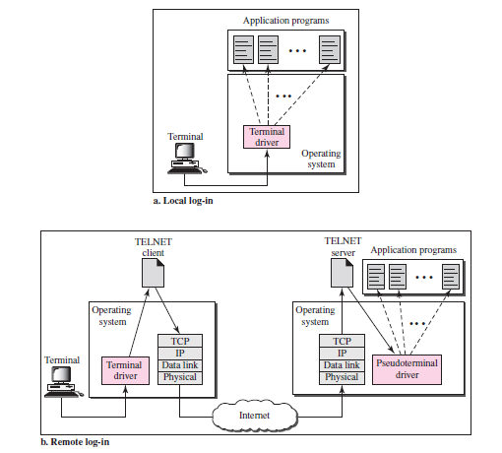
Remote login and local log in

Slide 31
Local Log-In-
When a user logs into a local timesharing system, it is called local log-in.
As a user types at a terminal or at a workstation running a terminal emulator, the keystrokes are accepted by the terminal driver.
The terminal driver passes the characters to the operating system. The operating system, in turn, interprets the combination of characters and invokes the desired application program or utility.
Remote Log-IN-
When a user wants to access an application program or utility located on a remote machine, performs remote log-in.
Here the TELNET client and server programs come into use. The user sends the keystrokes to the terminal driver, where the local operating system accepts the characters but does not interpret them

Slide 32
The characters are sent to the TELNET client, which transforms the characters to a universal character set called network virtual terminal (NVT) characters and delivers them to the local TCP/IP protocol stack.
The commands or text, in NVT form, travel through the Internet and arrive at the TCP/IP stack at the remote machine.
Here the characters are delivered to the operating system and passed to the TELNET server, which changes the characters to the corresponding characters understandable by the remote computer.
NVT – Network Virtual Terminal
The mechanism to access a remote computer is complex. This is so because every computer and its operating system accept a special combination of characters as tokens.
We are dealing with heterogeneous systems. If we want to access any remote computer in the world, we must first know what type of computer we will be connected to, and we must also install the specific terminal emulator used by that computer.

Slide 33
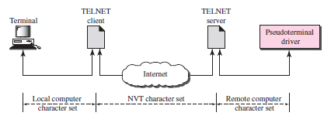
TELNET solves this problem by defining a universal interface called the network virtual terminal (NVT) character set.
Via this interface, the client TELNET translates characters (data or commands) that come from the local terminal into NVT form and delivers them to the network.
The server TELNET, on the other hand, translates data and commands from NVT form into the form acceptable by the remote computer

Slide 34
Electronic Mail (EMAIL)
One of the most popular Internet services is electronic mail (e-mail).
The designers of the Internet probably never imagined the popularity of this application program.
First we discuss the general architecture of an e-mail system including the three main components:
User agent (UA)
Message transfer agent (MTA)
Message access agent (MAA)
Architecture
To explain the architecture of e-mail, we give four scenarios.
We begin with the simplest situation and add complexity as we proceed. The fourth scenario is the most common in the exchange of email.

Slide 35
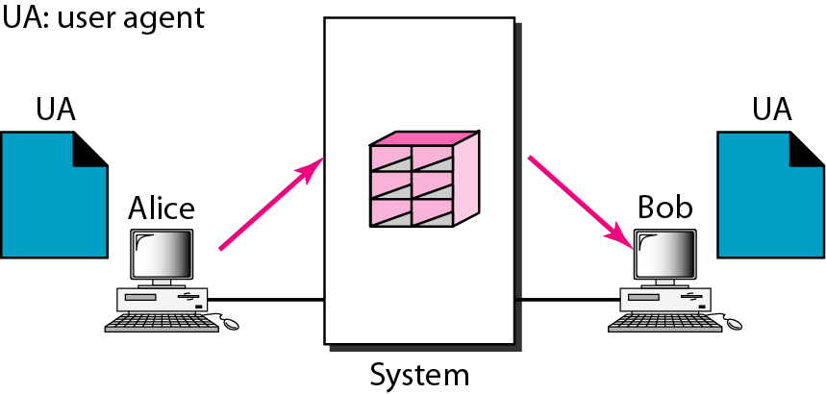
Electronic Mail (EMAIL) Architecture First Scenario
When the sender and the receiver of an e-mail are on the same system,
we need only two user agents.

Slide 36
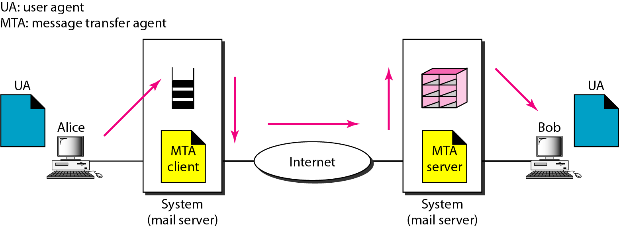
Electronic Mail (EMAIL) Architecture Second Scenario
When the sender and the receiver of an e-mail are on different systems, we need two UAs and a pair of MTAs (client and server).

Slide 37
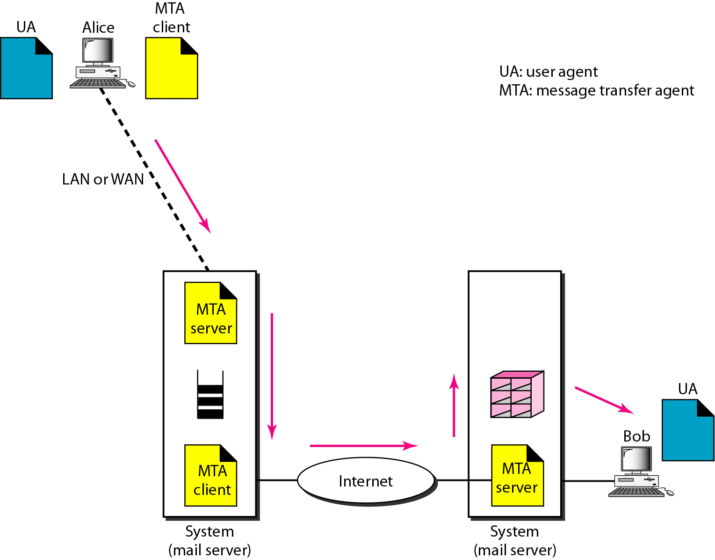
Electronic Mail (EMAIL) Architecture Third Scenario
When the sender is connected to the mail server via a LAN or a WAN,
we need two UAs and two pairs
of MTAs (client and server).

Slide 38
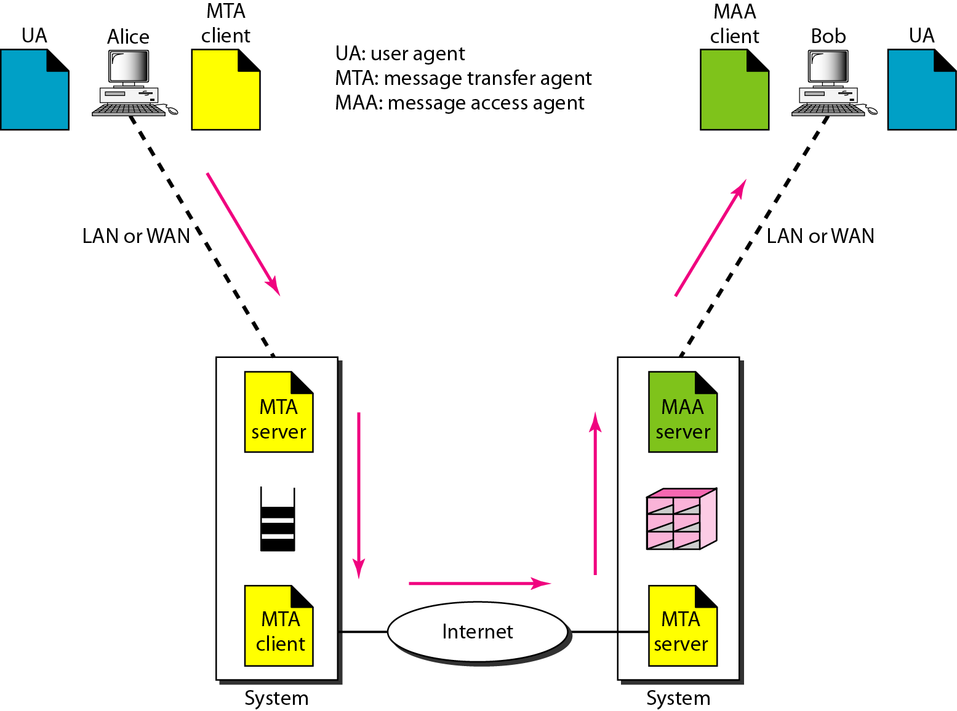
Electronic Mail (EMAIL) Architecture Fourth Scenario

Slide 39
When both sender and receiver are connected to the mail server via
a LAN or a WAN, we need two
UAs, two pairs of MTAs
and a pair of MAAs.
This is the most common situation today.

Slide 40
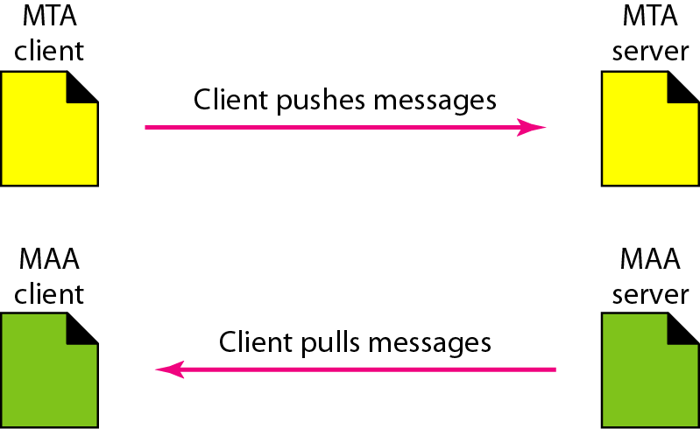
Push versus pull in electronic email

Slide 41
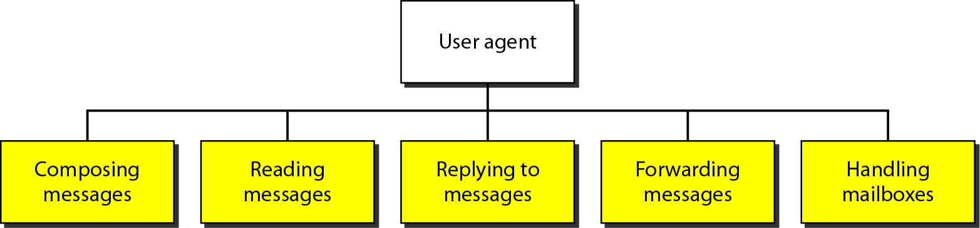
Services of user agent
It provides service to the user to make the process of sending and receiving a message easier.

Slide 42
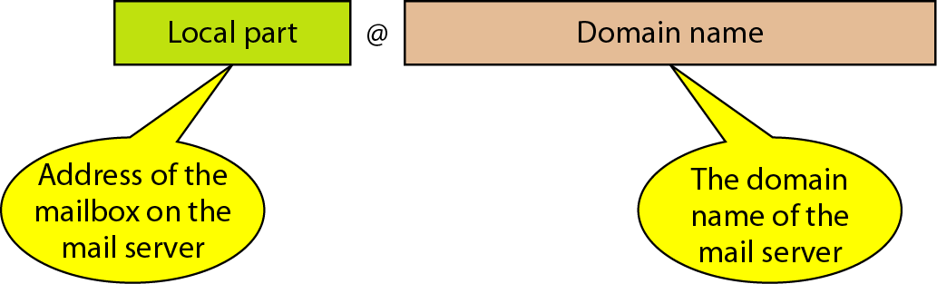
Electronic Mail (EMAIL) Addresses
To deliver mail, a mail handling system must use an addressing system with unique addresses.
In the Internet, the address consists of two parts: a local part and a domain name, separated by an @ sign

Slide 43
Electronic Mail (EMAIL) MIME
Electronic mail has a simple structure.
It can send messages only in NVT 7-bit ASCII format. In other words, it has some limitations.
For example, it cannot be used for languages that are not supported by 7-bit ASCII characters (such as French, German, Hebrew, Russian, Chinese, and Japanese). Also, it cannot be used to send binary files or video or audio data.
Multipurpose Internet Mail Extensions (MIME) is a supplementary protocol that allows non-ASCII data to be sent through e-mail.
MIME transforms non-ASCII data at the sender site to NVT ASCII data and delivers them to the client MTA to be sent through the Internet.
The message at the receiving side is transformed back to the original data.

Slide 44
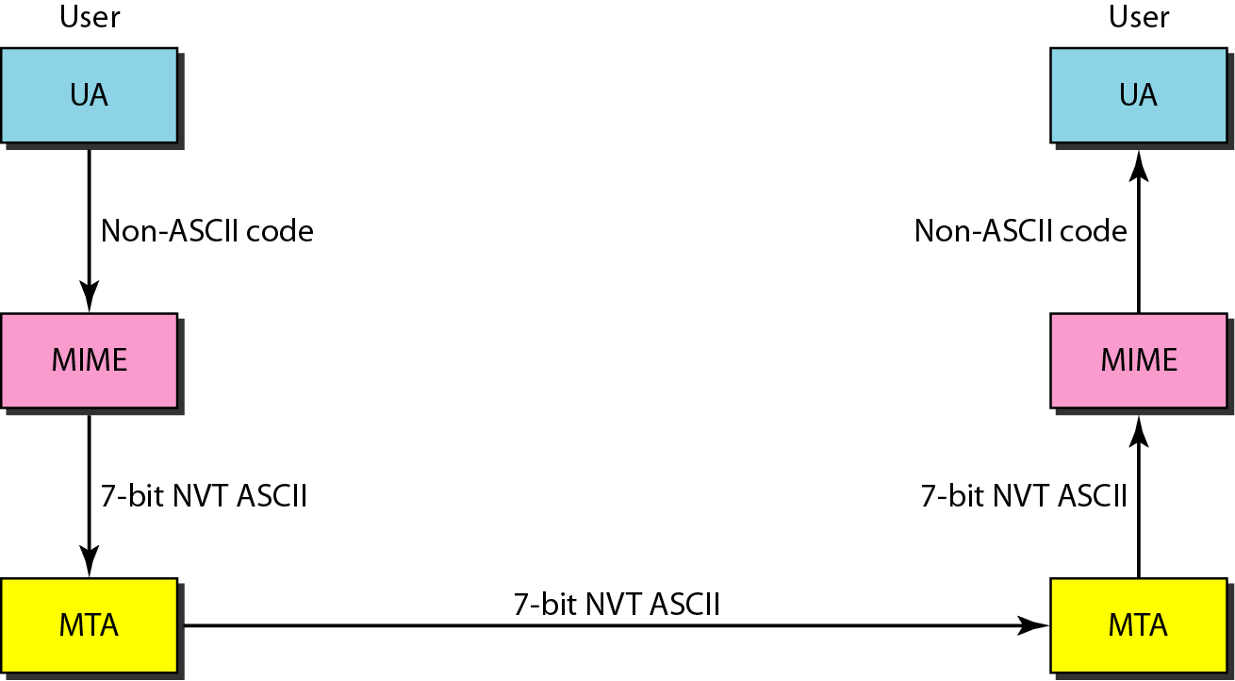
MIME (Multipurpose Internet Mail Extensions)

Slide 45
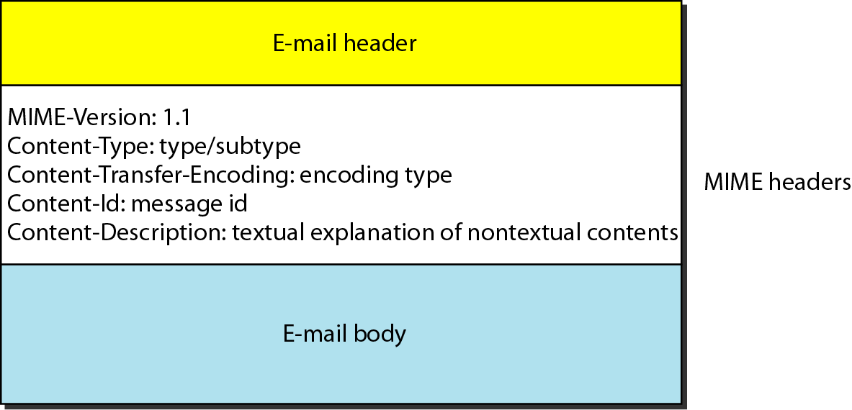
MIME header

Slide 46
MIME header Content type encoding

Slide 47
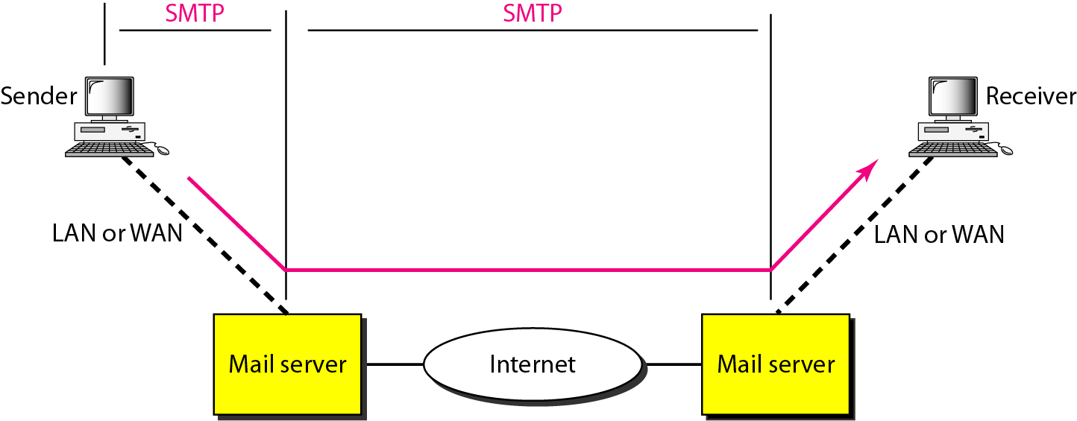
EMAIL Message Transfer Agent: SMTP
The actual mail transfer is done through message transfer agents.
To send mail, a system must have the client MTA, and to receive mail, a system must have a server MTA.
The formal protocol that defines the MTA client and server in the Internet is called the Simple Mail Transfer Protocol (SMTP).

Slide 48

Mechanism of mail transfer by SMTP
Commands and Responses
SMTP uses commands and responses to transfer messages between an MTA client and an MTA server
Commands- Commands are sent from the client to the server. The format of a command is shown in Figure
SMTP defines 14 commands.
The first five are mandatory; every implementation must support these five commands. The next three are often used and highly recommended. The last six are seldom used.

Slide 49
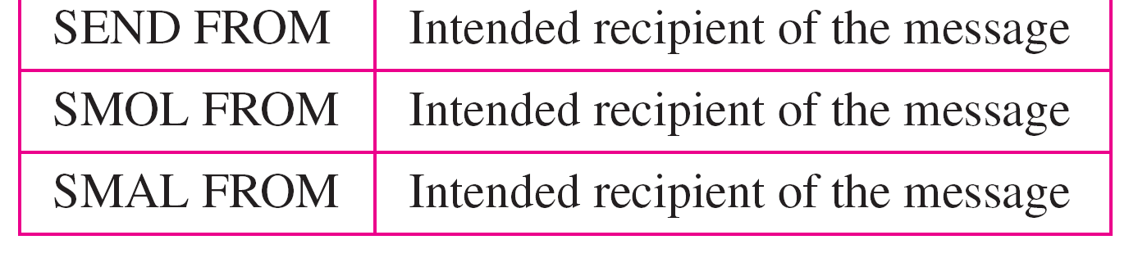

Slide 50
Mechanism of mail transfer by SMTP
Responses
Responses are sent from the server to the client. A response is a three digit code that may be followed by additional textual information
Mail Transfer Phases
The process of transferring a mail message occurs in three phases: connection establishment, mail transfer, and connection termination.

Slide 53
$ telnet mail.adelphia.net 25
Trying 68.168.78.100 . . .
Connected to mail.adelphia.net (68.168.78.100).

Slide 55
Message Access Agent: POP and IMAP
The first and the second stages of mail delivery use SMTP. However, SMTP is not involved in the third stage because SMTP is a push protocol; it pushes the message from the client to the server. In other words, the direction of the bulk data (messages) is from the client to the server.
On the other hand, the third stage needs a pull protocol; the client must pull messages from the server. The direction of the bulk data is from the server to the client.
The third stage uses a message access agent.
Currently two message access protocols are available: Post Office Protocol, version 3 (POP3) and Internet Mail Access Protocol, version 4 (IMAP4).

Slide 56
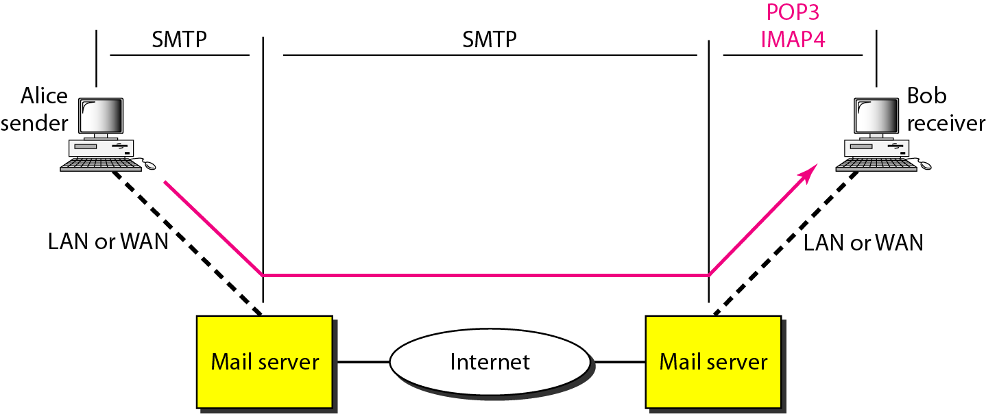

Slide 57
POP3
Post Office Protocol, version 3 (POP3) is simple and limited in functionality.
The client POP3 software is installed on the recipient computer; the server POP3 software is installed on the mail server.
Mail access starts with the client when the user needs to download e-mail from the mailbox on the mail server.
The client opens a connection to the server on TCP port 110.
It then sends its user name and password to access the mailbox.
The user can then list and retrieve the mail messages, one by one.
POP3 has two modes: the delete mode and the keep mode

Slide 58
POP3
In the delete mode, the mail is deleted from the mailbox after each retrieval.
In the keep mode, the mail remains in the mailbox after retrieval.
The delete mode is normally used when the user is working at her permanent computer and can save and organize the received mail after reading or replying.
The keep mode is normally used when the user accesses her mail away from her primary computer (e.g., a laptop).
The mail is read but kept in the system for later retrieval and organizing.

Slide 59
IMAP4
Another mail access protocol is Internet Mail Access Protocol, version 4 (IMAP4).
IMAP4 is similar to POP3, but it has more features; IMAP4 is more powerful and more complex.
POP3 is deficient in several ways. It does not allow the user to organize her mail on the server; the user cannot have different folders on the server. (Of course, the user can create folders on her own computer.)
In addition, POP3 does not allow the user to partially check the contents of the mail before downloading.

Slide 60
IMAP4
IMAP4 provides the following extra functions:
❏ A user can check the e-mail header prior to downloading.
❏ A user can search the contents of the e-mail for a specific string of characters prior to downloading.
❏ A user can partially download e-mail. This is especially useful if bandwidth is limited and the e-mail contains multimedia with high bandwidth requirements.
❏ A user can create, delete, or rename mailboxes on the mail server.
❏ A user can create a hierarchy of mailboxes in a folder for e-mail storage.

Slide 61
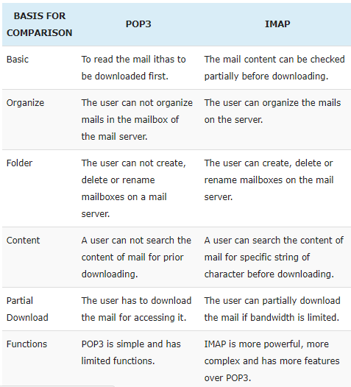

Slide 62
FILE TRANSFER Protocol
Transferring files from one computer to another is one of the most common tasks expected from a networking or internetworking environment.
As a matter of fact, the greatest volume of data exchange in the Internet today is due to file transfer.
In this section, we discuss one popular protocol involved in transferring files: File Transfer Protocol (FTP).
File Transfer Protocol (FTP)
File Transfer Protocol (FTP) is the standard mechanism provided by TCP/IP for copying a file from one host to another.
Although transferring files from one system to another seems simple and straightforward, some problems must be dealt with first.

Slide 63
FILE TRANSFER Protocol
For example, two systems may use different file name conventions. Two systems may have different ways to represent text and data.
Two systems may have different directory structures. All these problems have been solved by FTP in a very simple and elegant approach.
FTP differs from other client/server applications in that it establishes two connections between the hosts.
One connection is used for data transfer, the other for control information (commands and responses).
Separation of commands and data transfer makes FTP more efficient.

Slide 64
FILE TRANSFER Protocol
FTP uses two well-known TCP ports: Port 21 is used for the control connection, and port 20 is used for the data connection.
Figure shows the basic model of FTP.
The client has three components: user interface, client control process, and the client data transfer process
The server has two components: the server control process and the server data transfer process.
The control connection is made between the control processes. The data connection is made between the data transfer processes.

Slide 65
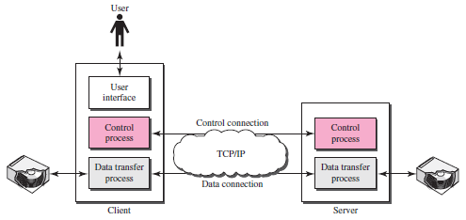
FTP Process

Slide 66
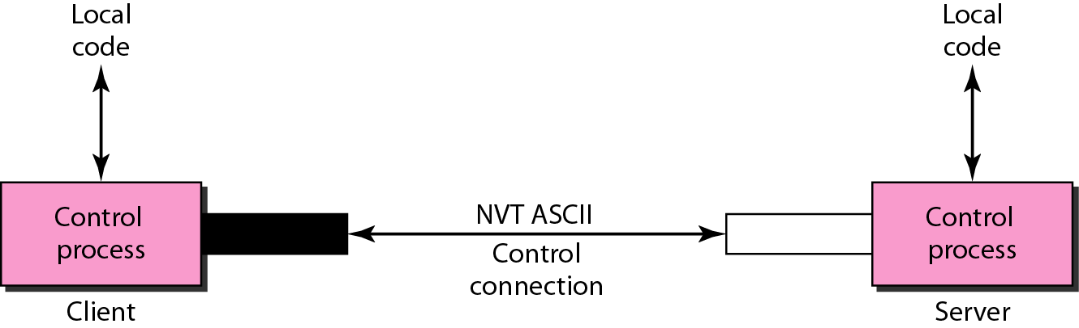
FILE TRANSFER Protocol
Communication over Control Connection
FTP uses the same approach as SMTP to communicate across the control connection. It uses the 7-bit ASCII character set
Communication is achieved through commands and responses. This simple method is adequate for the control connection because we send one command (or response) at a time.

Slide 67
FILE TRANSFER Protocol
Communication over Data Connection
The purpose of the data connection is different from that of the control connection.
We want to transfer files through the data connection.
File transfer occurs over the data connection under the control of the commands sent over the control connection.
However, we should remember that file transfer in FTP means one of three things:
❏ A file is to be copied from the server to the client. This is called retrieving a file. It is done under the supervision of the RETR command.
❏ A file is to be copied from the client to the server. This is called storing a file. It is done under the supervision of the STOR command

Slide 68
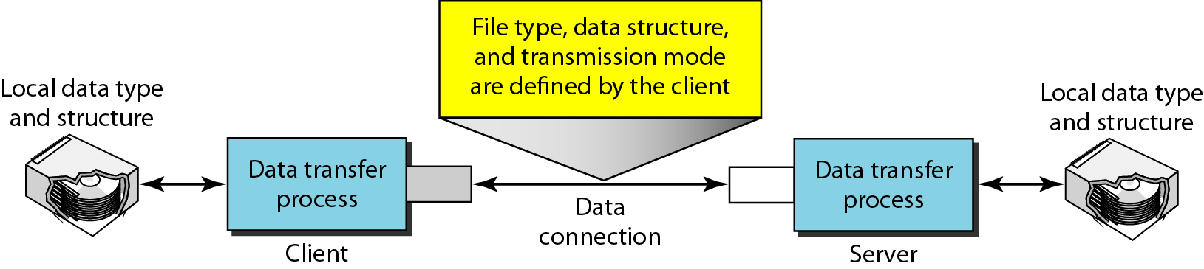
FILE TRANSFER Protocol
❏ A list of directory or file names is to be sent from the server to the client. This is done under the supervision of the LIST command.

Slide 69
WWW
WWW: The term WWW refers to the World Wide Web or simply the
Web. The World Wide Web consists of all the public Web sites
connected to the Internet worldwide, including the client devices (such
as computers and cell phones) that access Web content. The WWW is
just one of many applications of the Internet and computer networks.
The World Web is based on these technologies:
• HTML - Hypertext Markup Language
• HTTP - Hypertext Transfer Protocol
• Web servers and Web browsers
Tim Berners-lee, a research scientist at the European particles Physics
Laboratory (CERN) in Geneva, Switzerland, developed the concept of
WWW in 1989.

Slide 70
HTTP
Typically the client program (i.e., browser) runs on a separate machine from that of the server. The server takes care of all the issues related to
document storage where as the task of presenting the information to the user is left to the client program. Web clients and servers can communicate with each other by the protocol is called the Hypertext Transfer Protocol, (Known as HTTP). All web clients and servers must use HTTP.

Slide 71
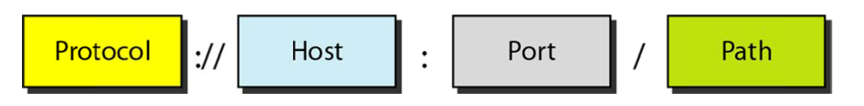
URL

Slide 72
WWW and HTTP
The World Wide Web (WWW) is a repository of information linked together from points all over the world.
The WWW has a unique combination of flexibility, portability, and user-friendly features that distinguish it from other services provided by the Internet.
The WWW today is a distributed client/server service, in which a client using a browser can access a service using a server. However, the service provided is distributed over many locations called sites, as shown in Figure

Slide 73
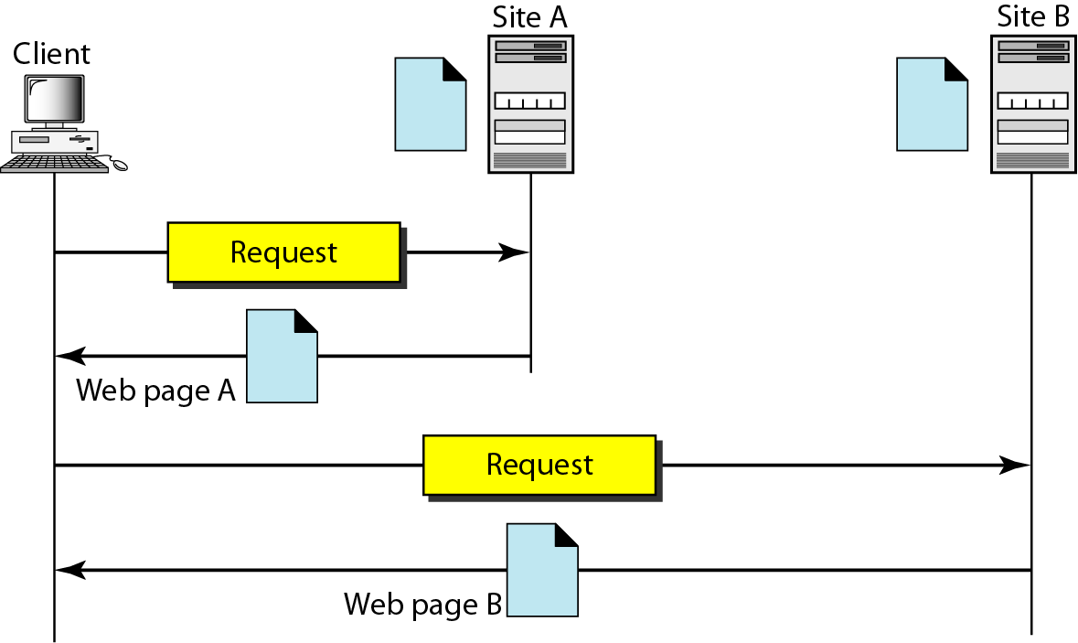

Slide 74
Client (Browser)
A variety of vendors offer commercial browsers that interpret and display a Web document, and all use nearly the same architecture.
Each browser usually consists of three parts:
a controller,
client protocol, and
interpreters.
The controller receives input from the keyboard or the mouse and uses the client programs to access the document.
After the document has been accessed, the controller uses one of the interpreters to display the document on the screen

Slide 75
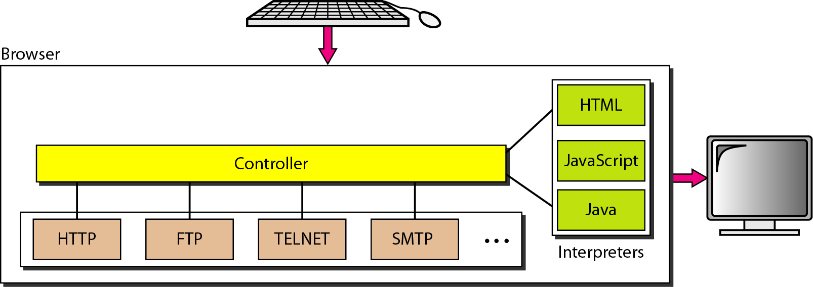

Slide 76
Server
The Web page is stored at the server. Each time a client request arrives, the corresponding document is sent to the client.
To improve efficiency, servers normally store requested files in a cache in memory; memory is faster to access than disk.
A server can also become more efficient through multithreading or multiprocessing
Uniform Resource Locator
A client that wants to access a Web page needs the address.
To facilitate the access of documents distributed throughout the world, HTTP uses locators.
The uniform resource locator (URL) is a standard for specifying any kind of information on the Internet.
The URL defines four things: protocol, host computer, port, and path

Slide 77
Web Document
The documents in the WWW can be grouped into three broad categories: static, dynamic, and active.
The category is based on the time at which the contents of the document are determined.
Static Documents
Static documents are fixed-content documents that are created and stored in a server. The client can get only a copy of the document

Slide 78
Dynamic Documents
A dynamic document is created by a Web server whenever a browser requests the document.
When a request arrives, the Web server runs an application program or a script that creates the dynamic document.
The server returns the output of the program or script as a response to the browser that requested the document
Active Documents
For many applications, we need a program or a script to be run at the client site. These are called active documents.
For example, suppose we want to run a program that creates animated graphics on the screen or a program that interacts with the user.
The program definitely needs to be run at the client site where the animation or interaction takes place

Slide 79
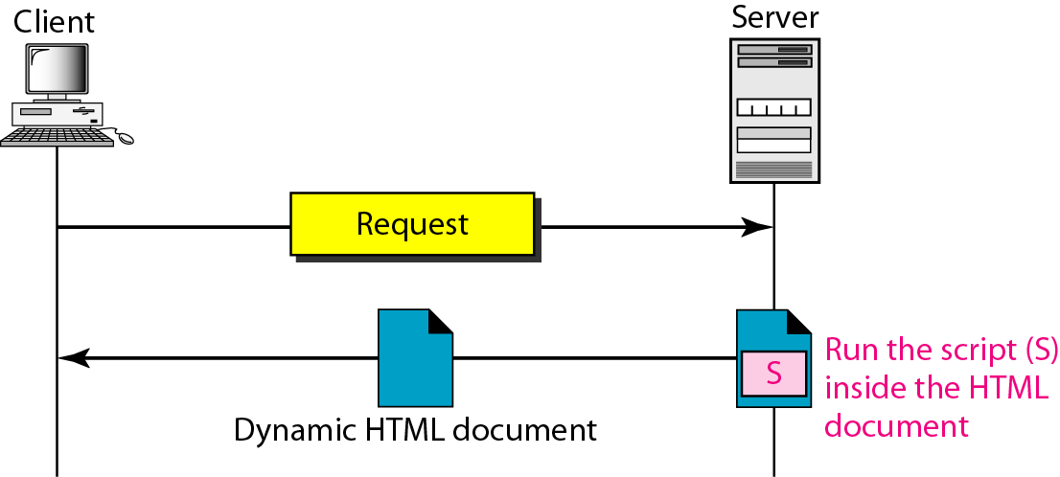
Dynamic documents are sometimes referred to as server-site dynamic documents.

Slide 80
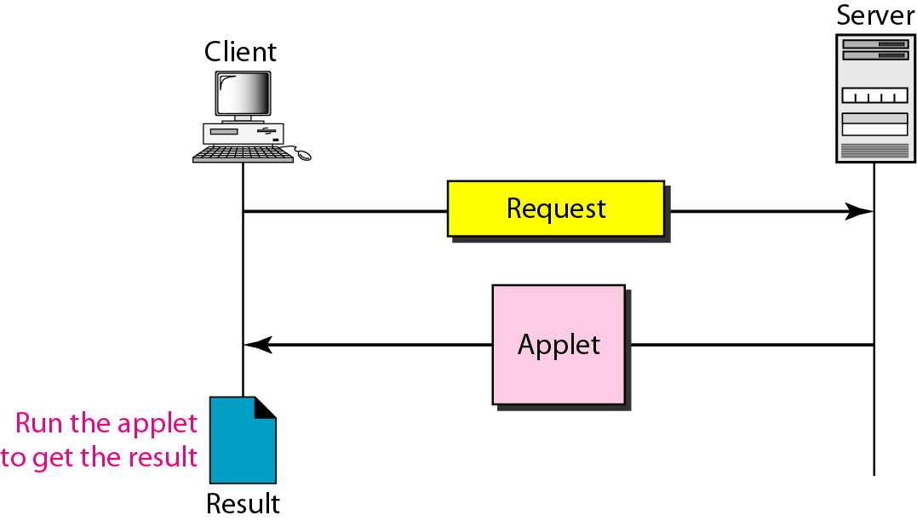
Active documents are sometimes referred to as client-site dynamic documents.

Slide 81
HTTP
The Hypertext Transfer Protocol (HTTP) is a protocol used mainly to access data on the World Wide Web.
HTTP functions as a combination of FTP and SMTP. It is similar to FTP because it transfers files and uses the services of TCP.
However, it is much simpler than FTP because it uses only one TCP connection.
There is no separate control connection; only data are transferred between the client and the server.
HTTP is like SMTP because the data transferred between the client and the server look like SMTP messages.
HTTP uses the services of TCP on well-known port 80.

Slide 82
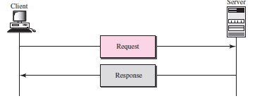
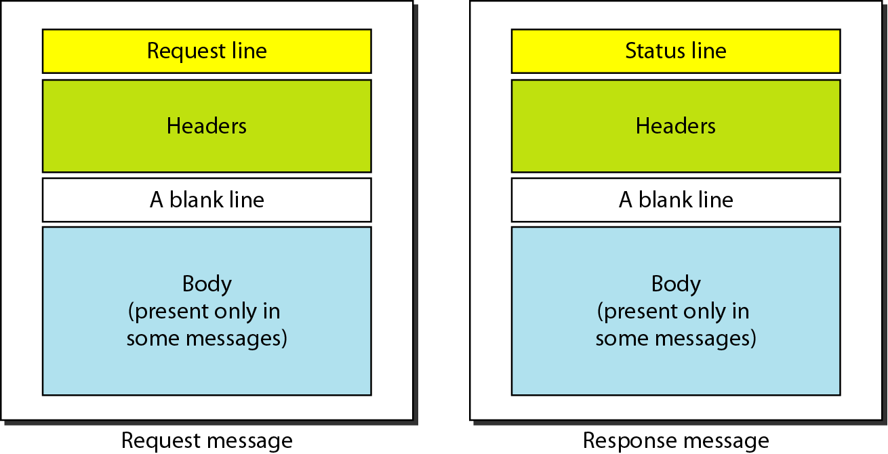
HTTP transaction

Slide 83
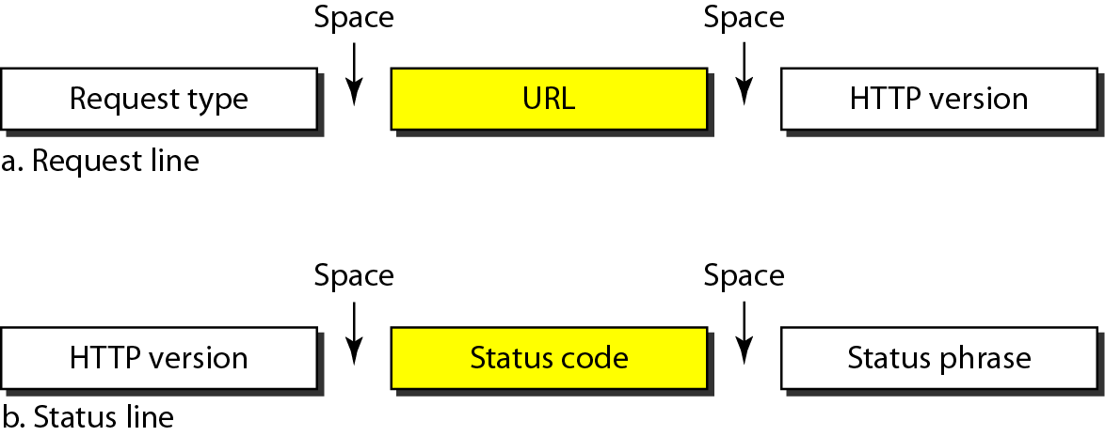
Figure Request and status lines

Slide 84
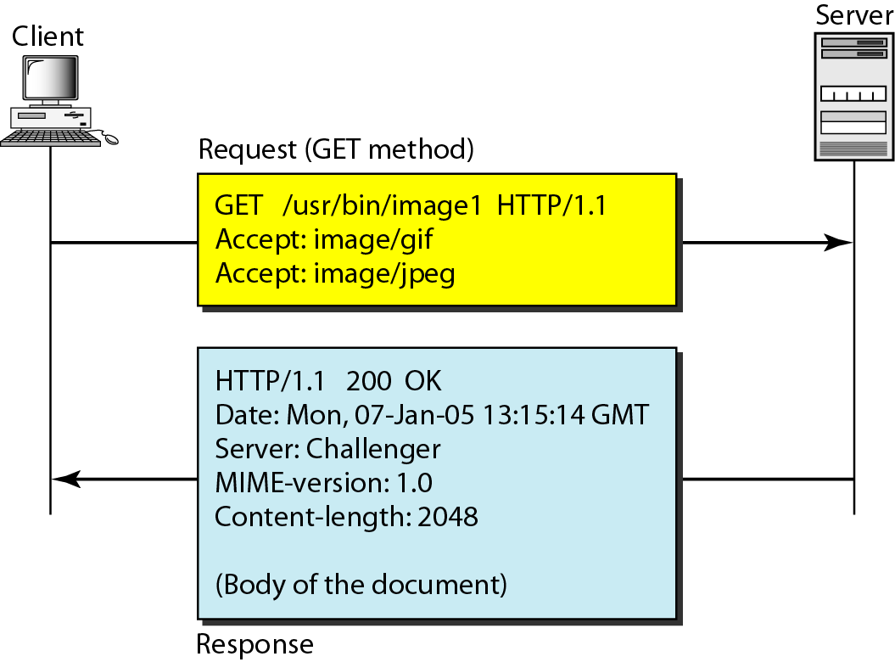
HTTP Transaction Example -1

Slide 85
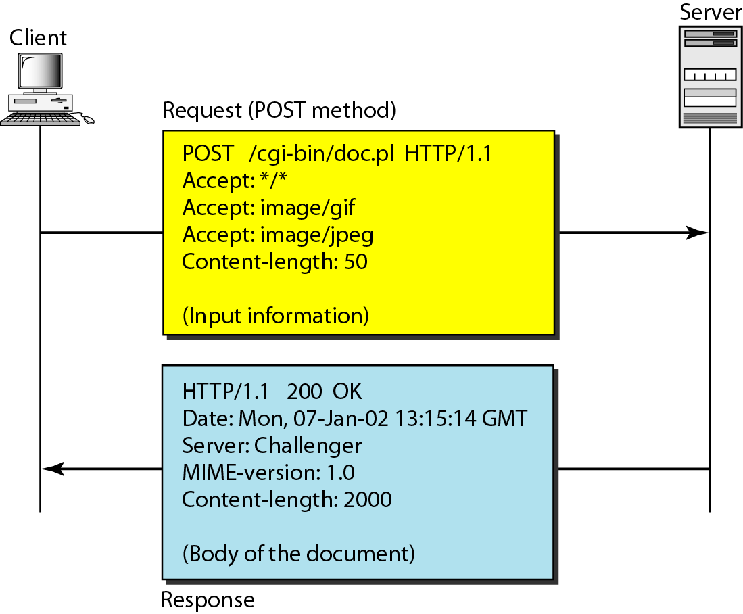
HTTP Transaction Example -2

Slide 86
Persistent Versus Nonpersistent HTTP Connection
HTTP prior to version 1.1 specified a nonpersistent connection, while a persistent connection is the default in version 1.1 Nonpersistent Connection
In a nonpersistent connection, one TCP connection is made for each request/response.
The following lists the steps in this strategy: 1. The client opens a TCP connection and sends a request. 2. The server sends the response and closes the connection. 3. The client reads the data until it encounters an end-of-file marker; it then closes the connection
In this strategy, for N different pictures in different files, the connection must be opened and closed N times.

Slide 87
Persistent Versus Nonpersistent HTTP Connection
Persistent Connection
HTTP version 1.1 specifies a persistent connection by default. In a persistent connection, the server leaves the connection open for more requests after sending a response.
The server can close the connection at the request of a client or if a time-out has been reached.

Slide 88
Network Management: SNMP
We can define network management as
monitoring,
testing,
configuring, and
troubleshooting
network components to meet a set of requirements defined by an organization.
These requirements include the smooth, efficient operation of the network that provides the predefined quality of service for users

Slide 89
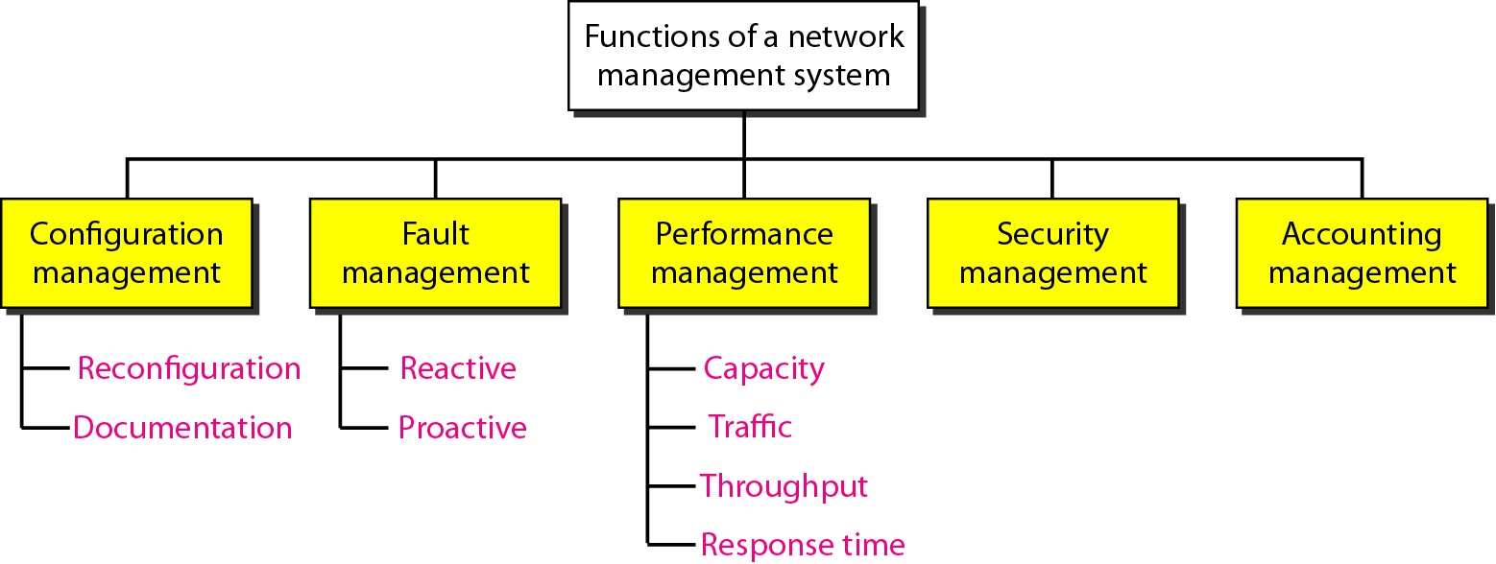
NETWORK MANAGEMENT SYSTEM

Slide 90
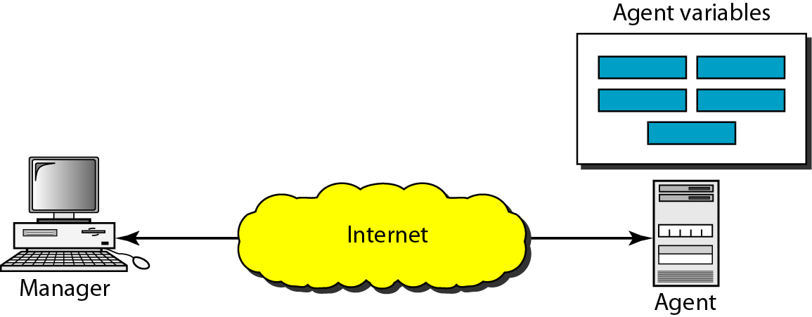
SIMPLE NETWORK MANAGEMENT PROTOCOL (SNMP)
The Simple Network Management Protocol (SNMP) is a framework for managing devices in an internet using the TCP/IP protocol suite.
It provides a set of fundamental operations for monitoring and maintaining an internet.
Concept
SNMP uses the concept of manager and agent. That is, a manager, usually a host, controls and monitors a set of agents, usually routers

Slide 91
SNMP is an application-level protocol in which a few manager stations control a set of agents.
The protocol is designed at the application level so that it can monitor devices made by different manufacturers and installed on different physical networks.
Managers and Agents
A management station, called a manager, is a host that runs the SNMP client program.
A managed station, called an agent, is a router (or a host) that runs the SNMP server program.
Management is achieved through simple interaction between a manager and an agent.
The agent keeps performance information in a database. The manager has access to the values in the database.
For example, a router can store in appropriate variables the number of packets received and forwarded. The manager can fetch and compare the values of these two variables to see if the router is congested or not.

Slide 92
Agent
Agents can also contribute to the management process.
The server program running on the agent can check the environment, and if it notices something unusual, it can send a warning message, called a trap, to the manager.
In other words, management with SNMP is based on three basic ideas:
1. A manager checks an agent by requesting information that reflects the behaviour of the agent.
2. A manager forces an agent to perform a task by resetting values in the agent database.
3. An agent contributes to the management process by warning the manager of an unusual situation.

Slide 93
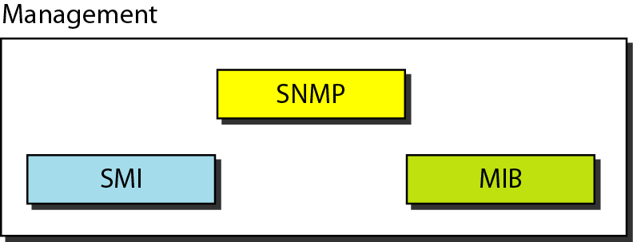
Management Components
To do management tasks, SNMP uses two other protocols: Structure of Management Information (SMI) and Management Information Base (MIB).
In other words, management on the Internet is done through the cooperation of the three protocols SNMP, SMI, and MIB

Slide 94
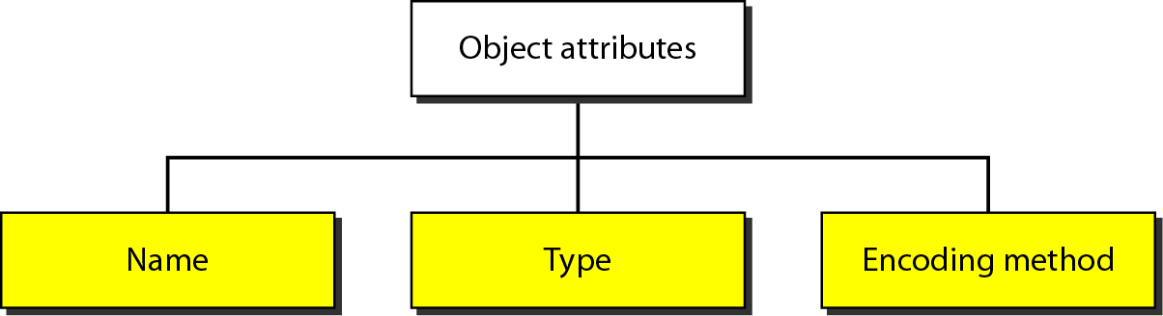
Structure of Management Information (SMI)
The Structure of Management Information, version 2 (SMIv2) is a component for network management.
Its functions are
1. To name objects
2. To define the type of data that can be stored in an object
3. To show how to encode data for transmission over the network
SMI is a guideline for SNMP. It emphasizes three attributes to handle an object: name, data type, and encoding method

Slide 95
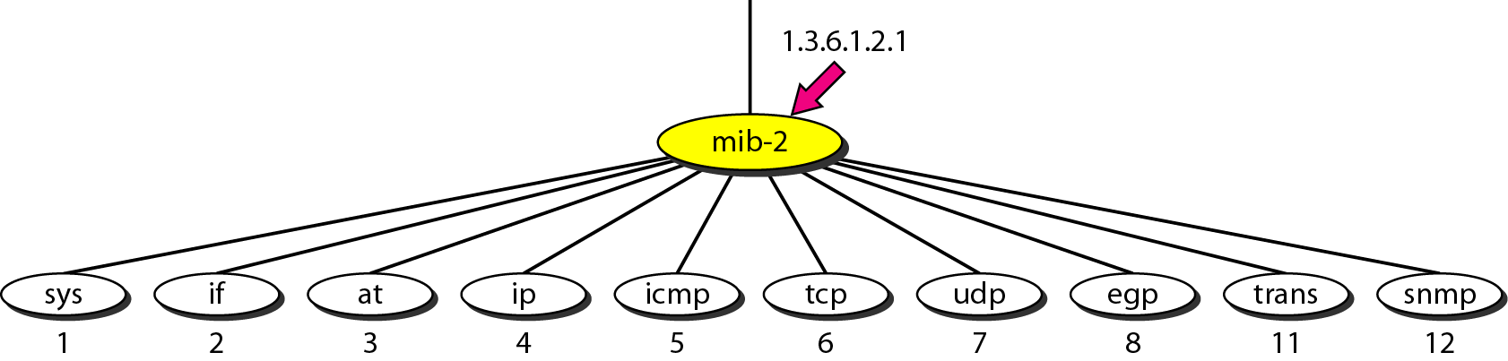
Management Information Base (MIB)
The Management Information Base, version 2 (MIB2) is the second component used in network management.
Each agent has its own MIB2, which is a collection of all the objects that the manager can manage.
The objects in MIB2 are categorized under 10 different groups: system, interface, address translation, ip, icmp, tcp, udp, egp, transmission, and snmp. These groups are under the mib-2 object in the object identifier tree

Slide 96
The following is a brief description of some of the objects:
❏ sys This object (system) defines general information about the node (system), such as the name, location, and lifetime.
❏ if This object (interface) defines information about all the interfaces of the node including interface number, physical address, and IP address.
❏ at This object (address translation) defines the information about the ARP table.
❏ ip This object defines information related to IP, such as the routing table and the IP address.
❏ icmp This object defines information related to ICMP, such as the number of packets sent and received and total errors created.
❏ tcp This object defines general information related to TCP, such as the connection table, time-out value, number of ports, and number of packets sent and received.
❏ udp This object defines general information related to UDP, such as the number of ports and number of packets sent and received.
❏ snmp This object defines general information related to SNMP itself.

Slide 97
SNMP
SNMP uses both SMI and MIB in Internet network management. It is an application program that allows
1. A manager to retrieve the value of an object defined in an agent
2. A manager to store a value in an object defined in an agent
3. An agent to send an alarm message about an abnormal situation to the manager
PDUs (protocol data unit)
SNMPv3 defines eight types of packets (or PDUs):
GetRequest,
GetNextRequest,
Get- BulkRequest,
SetRequest,
Response,
Trap,
InformRequest, and
Report

Slide 98
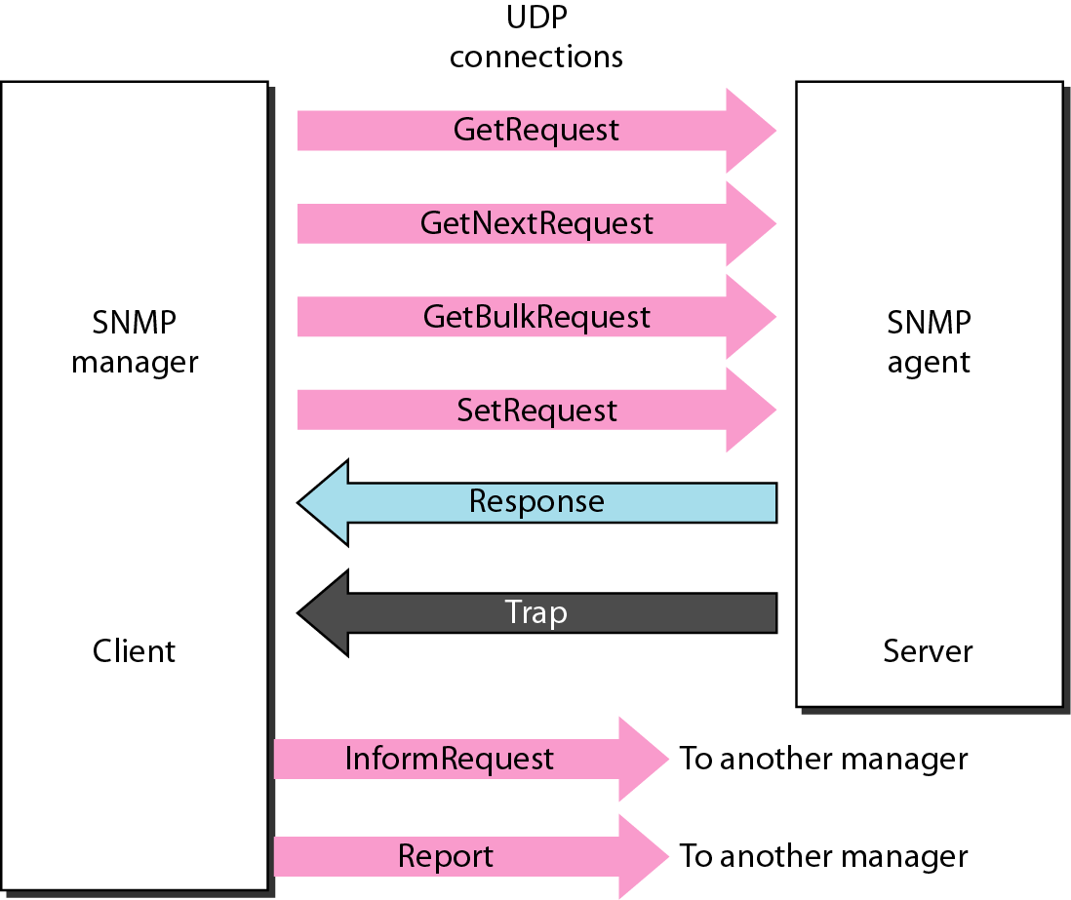

Slide 99
Cryptography: basic concepts
Four Aspect of Security
Network Security
privacy
Authentication
Integrity
Non-repudiation

Slide 100
Privacy – privacy means that the sender and receiver accept confidentiality.
Authentication- authentication means that the receiver is sure of the sender’s identity and that an imposter has not send the message
Integrity- data integrity means that the data must arrive at receiver exactly as it was sent
Non- repudiation - non-repudiation means that a receiver must be able to prove that received message came from a specific sender

Slide 101
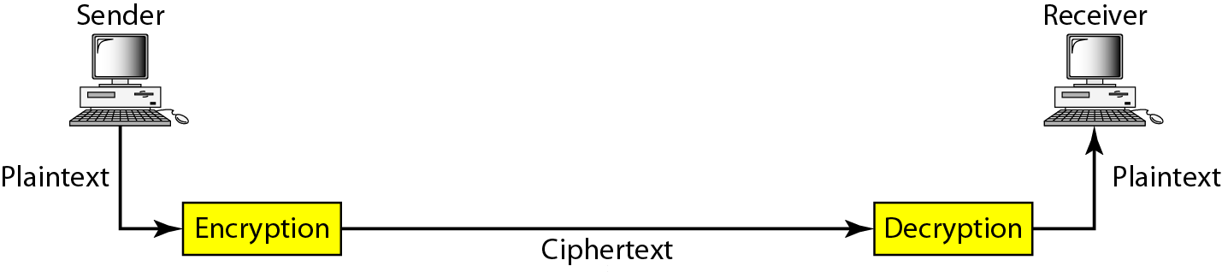
Cryptography: basic concepts
Cryptography
Cryptography, a word with Greek origins, means “secret writing.”
However, we use the term to refer to the science and art of transforming messages to make them secure and immune to attacks
components involved in cryptography

Slide 102
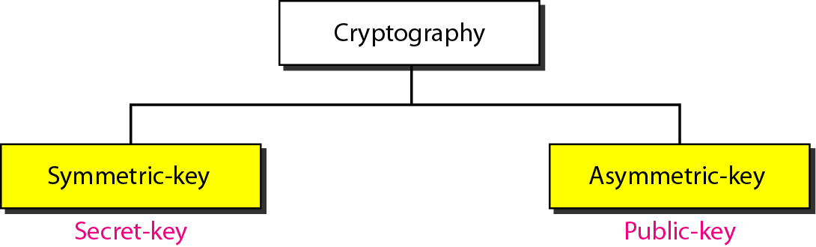
The original message, before being transformed, is called plaintext.
After the message is transformed, it is called ciphertext.
An encryption algorithm transforms the plaintext into ciphertext;
A decryption algorithm transforms the ciphertext back into plaintext.
The sender uses an encryption algorithm, and the receiver uses a decryption algorithm.

Slide 103
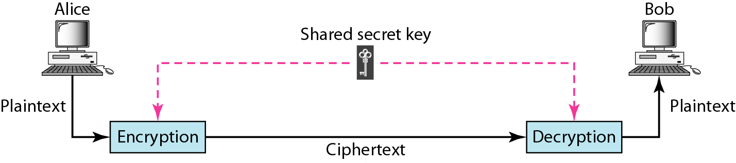
Symmetric-Key Cryptography
In symmetric-key cryptography, the same key is used by both parties.
The sender uses this key and an encryption algorithm to encrypt data;
the receiver uses the same key and the corresponding decryption algorithm to decrypt the data

Slide 104
Symmetric-Key cryptography
Advantage
Secret key algorithm are efficient
It takes less time to encrypt a message using secret key
Key in secret key encryption is usually smaller
Disadvantage
Each pair of users must have a secret key. This mean that if N persons in the world want to use this method, there needs to be n(n-1)/2 secret keys.
Distribution of secret key between two parties can be difficult

Slide 105

Asymmetric-Key Encryption (public key cryptography)
In asymmetric or public-key cryptography, there are two keys: a private key and a public key.
The private key is kept by the receiver.
The public key is announced to the public.
Alice wants to send a message to Bob. Alice uses the public key to encrypt the message. When the message is received by Bob, the private key is used to decrypt the message.

Slide 106
Asymmetric-Key Encryption (public key cryptography)
Advantage
In public key cryptography, each entity create own pair of keys one is the private and other one distribute publically
Number of keys reduce tremendously
Disadvantage
Big disadvantage of this encryption is the complexity of the algorithm
Generally keys are very large so that long keys takes lot of time to find cipher

Slide 107
Digital Signature
Integrity, non-repudiation and authentication provide by the digital signature process.
The idea is similar to the signing of a document.
We have two choices: we can sign the entire document and we can sign a digest of the document
Signing the whole document
Public key encryption can be used to sign a document .
Role of public and private key are different here.
Sender uses her private key to encrypt the message just as a person uses her signature
Receiver use public key

Slide 108

Signing the Digest
If the message is long then private key method does not work efficiently
Instead of signing whole document we first calculate digest of document by using hash function
Then signed the digest document and send to rciever

Slide 109
RSA
by Ron Rivest, Adi Shamir & Len Adleman of MIT in 1977
best known & widely used public-key scheme
Is a block cipher in which plain & cipher text are integers between 0 to n-1 for some n.
uses large integers (e.g. n=1024 bits)
Plain text is encrypted in blocks having a binary value less than some number n.
C=Me mod n
M=C^{d} mod n=M^{ed} mod n

Slide 110
RSA Use
to encrypt a message M the sender:
obtains public key of recipient PU={e,n}
computes: C = Me mod n, where 0≤M<n
to decrypt the ciphertext C the owner:
uses his/her private key PR={d,n}
computes: M = C^{d} mod n
Note-> that the message M must be smaller than the modulus n (block if needed)

Slide 111
RSA Key Setup
each user generates a public/private key pair by:
selecting two large primes at random - p, q
computing their system modulus n=p*q
Calculate ø(n)=(p-1)(q-1)
selecting at random the encryption key e
where 1<e<ø(n), gcd( e, ø(n))=1
solve following equation to find decryption key d
e*d=1 mod ø(n) and 0≤d≤n
publish their public encryption key: PU={e, n}
keep secret private decryption key: PR={d, n}

Slide 112
RSA Example - Key Setup
Select primes: p=17 & q=11
Compute n = pq =17 x 11=187
Compute ø(n)=(p–1)(q-1)=16 x 10=160
Select e: gcd(e,160)=1; choose e=7
Determine d: de=1 mod 160 and d < 160
Value is d=23 since 23x7=161= 10x16+1
Publish public key PU={7,187}
Keep secret private key PR={23,187}

Slide 113
RSA Example - En/Decryption
sample RSA encryption/decryption is:
given message M = 88 (nb. 88<187)
encryption:
C = 88⁷ mod 187 = 11
decryption:
M = 11²³ mod 187 = 88

Slide 114
THE END

